Slide 1
Stability of Perovskite Materials using Machine Learning
By ,
Navaneeth P R
B-Tech Engineering Physics , IIT Roorkee
Enrollment no: 19122021

Slide 2
Data Preparation
540 datasets of halide double perovskites were chosen to build the model.
The datasets contained information about the properties of the elements which were present in the double perovskites which were calculated using first principles.
The dataset was taken from this source : dataset_article.
The dataset contained 32 parameters as descriptors for double halide perovskites.
These are used to build a model that predicts the thermodynamic stability based on heat of formation of the perovskite material.

Slide 3
Feature Encoding
In the modelling process , eliminating and reducing the features in an effective way to improve the predictive ability of the model.
Since there are 32 features in the dataset , we try to reduce the dimension of these features into 10 .
Instead of using normal dimensionality reduction techniques like PCA (Principal Component Analysis) which do not account for the non-linear relationships in the dataset , we use a deep learning model called ‘Autoencoders’ to encode these 32 features into 10 features.

Slide 4
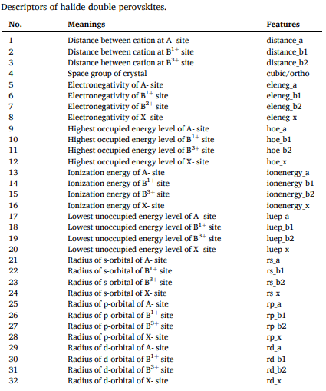

Slide 5
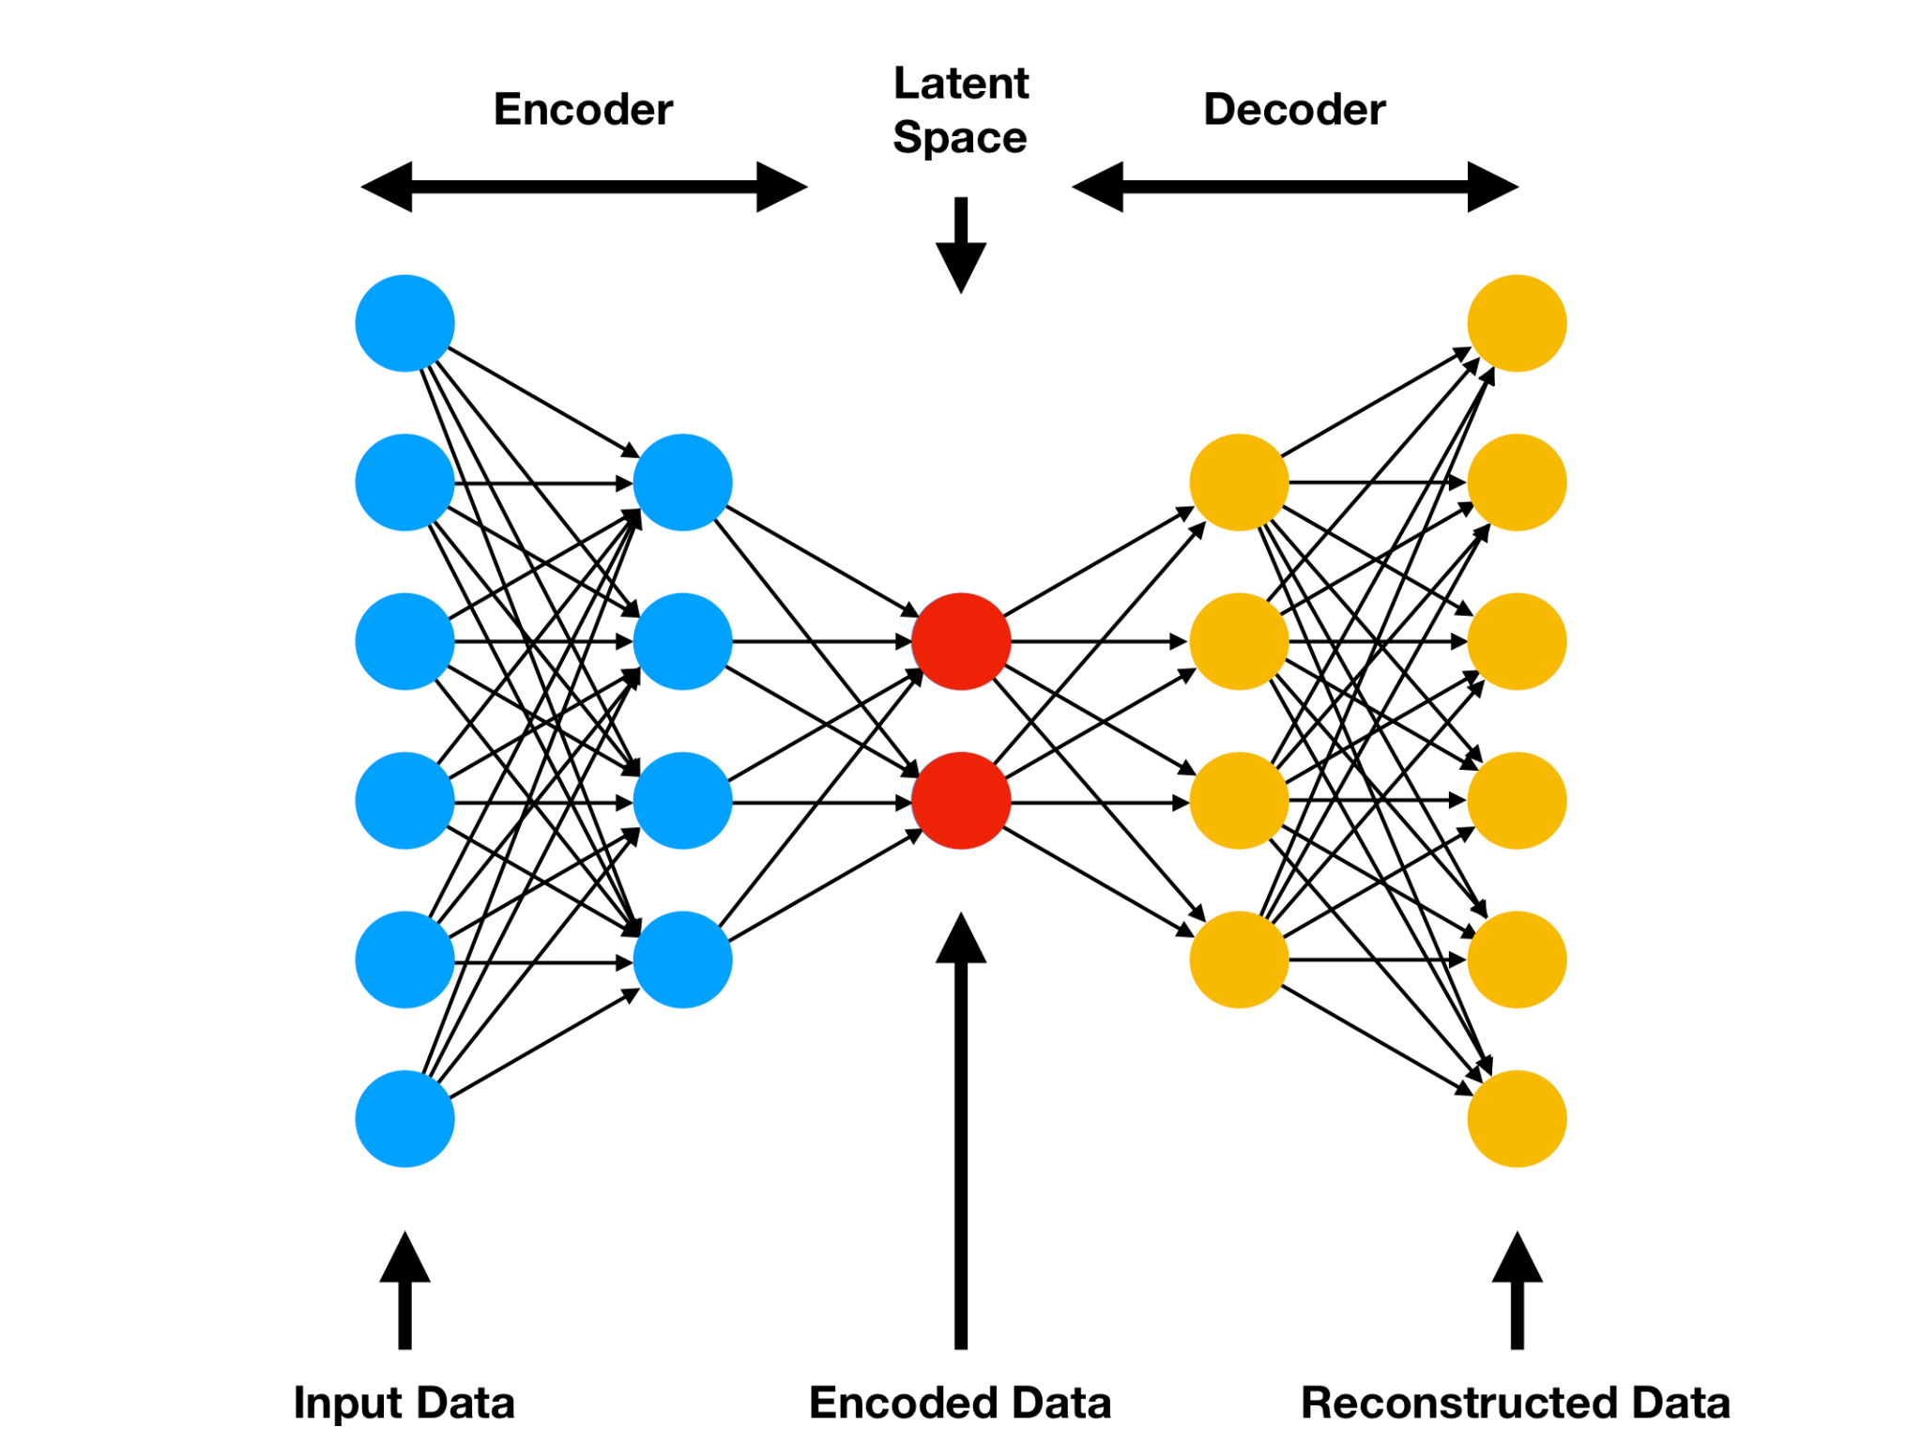
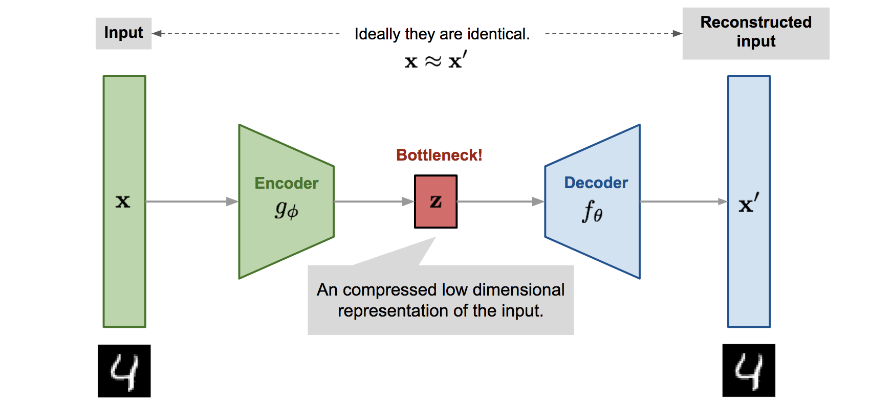
AutoEncoder Neural Networks
Autoencoders are a part of unsupervised deep learning techniques. It takes a set of inputs (X) and passes it through a set of hidden layers and aims to create outputs which are similar to the inputs (X’).

Slide 6
The encoder part of the network encodes the input into a hidden bottle-neck layer and the decoder part uses specific weights and biases to reconstruct those inputs from these hidden layers.
Once the encoder-decoder networks learns to replicate the input (X) in the output (X’) the hidden bottle-neck layer would represent a compressed version of the input (X).
The number of hidden neurons in the bottle-neck layer (here its 10) is smaller than the input layer neurons (32) so the dimension of the feature space also gets reduced to the latent space dimension (10).
Autoencoders can learn more non-linear complex representations in the data compared to PCA, this is the reason for the usage of Autoencoders.

Slide 7
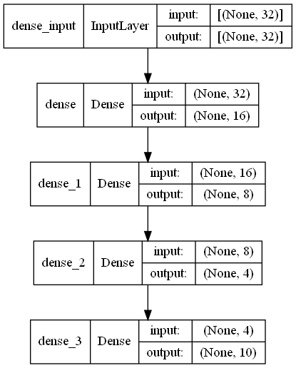
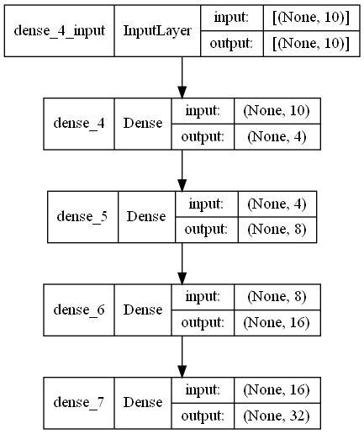
Architecture of Autoencoder used in Feature Encoding
Encoder
Decoder

Slide 8
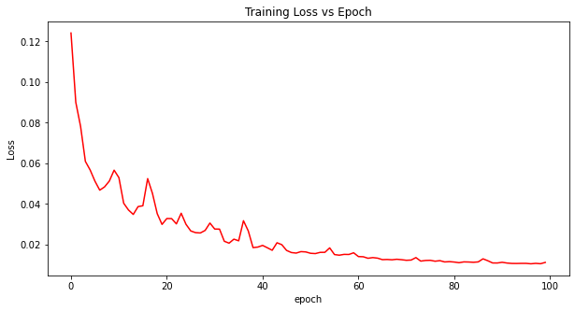
Training of Autoencoder
The autoencoder was trained on the 32 input parameters with about 1.03 % error .
After training the encoder part of the network was used to encode these into just 10 parameters (x1, x2, x3,...x10) which are latent (sparse) representations of the input features.

Slide 9
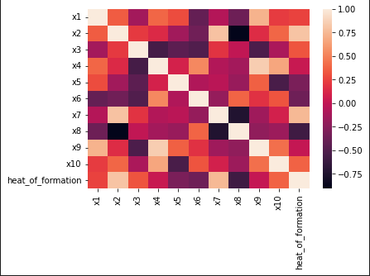
Eliminating Multicollinearity From Encoded Data
We use correlation matrix and heatmap to eliminate multicollinearity (correlation between independent variables) so that our regression model becomes more robust and statistically correct in predictions.
From the correlation matrix we can see the
variable pairs (x2,x8) , (x4,x9) , (x2,x7) have
absolute correlation > 0.75 , also x4 and x9 have
less correlation with the heat of formation, so we
can discard the variables x4,x7,x8,x9 .
Now our model has 6 variables to
predict the heat of formation.

Slide 10
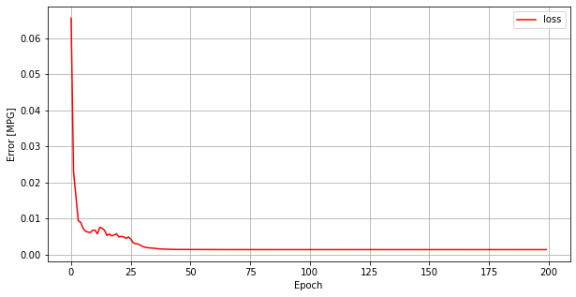
Deep Learning Model for stability prediction
A dense neural network was trained on these encoded features (x1,x2,x3,x5,x6,x10) with heat of formation( H) as the dependent variable.
The model was trained with a final loss of 0.13%.

Slide 11
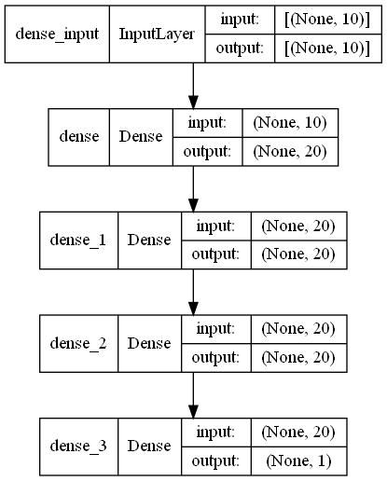
Architecture of the Deep Learning Model

Slide 12
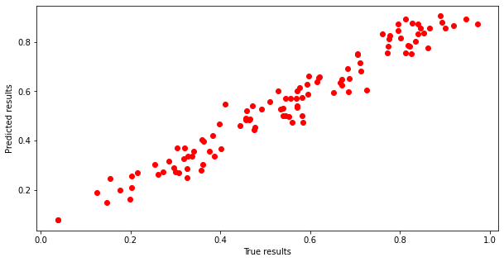
Testing The Model
The encoded dataset was split into 2 sets, 432 samples were used to train the deep learning model and 108 samples were used to test the model’s prediction performance.
The model predicted the heat of formation with a mean squared error of about 0.24% and the R2 score of the model is 0.9535 which is a good fit for the deep learning regression model.
From the plot of predicted heat of formation
vs the true heat of formation we can see that
the plot almost follows a straight line at 45
degrees passing through the origin which also
indicates the goodness of fit of the model.

Slide 13
Links of Code and Notebooks
References
Feature Encoder Notebook : Feature Extractor
Deep Learning Model : dl_model
Code and Datasets: Git Repo
Machine learning stability and band gap of lead-free halide double perovskite materials for perovskite solar cells
How To Perform Data Compression Using Autoencoders?

